Slide 1


Docker
The Docker engine architecture

Slide 2
Lesson Agenda
To examine the components of Docker engine

Slide 3
Introduction
The Docker engine is the core software that runs and manages containers. We often refer to it simply as Docker.
It is modular in design and built from many small specialized tools. Where possible, these are based on open standards such as those maintained by the Open Container Initiative (OCI).
The major components that make up the Docker engine are; the Docker daemon, containerd, runc, and various plugins such as networking and storage. Together, these create and run containers.

Slide 4
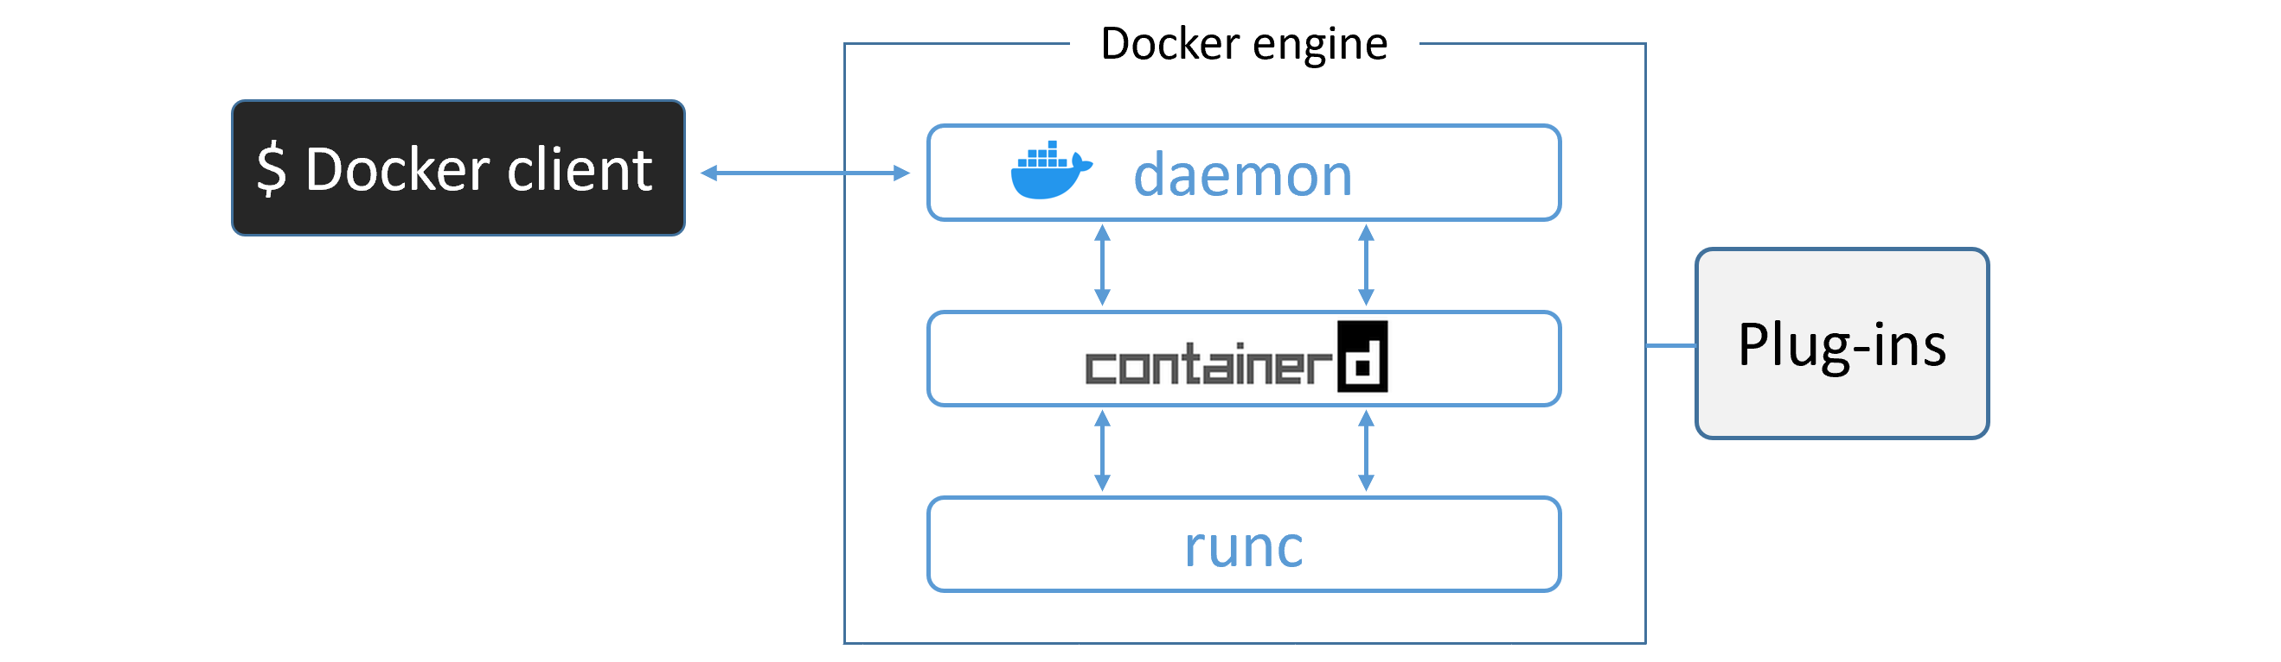

Slide 5
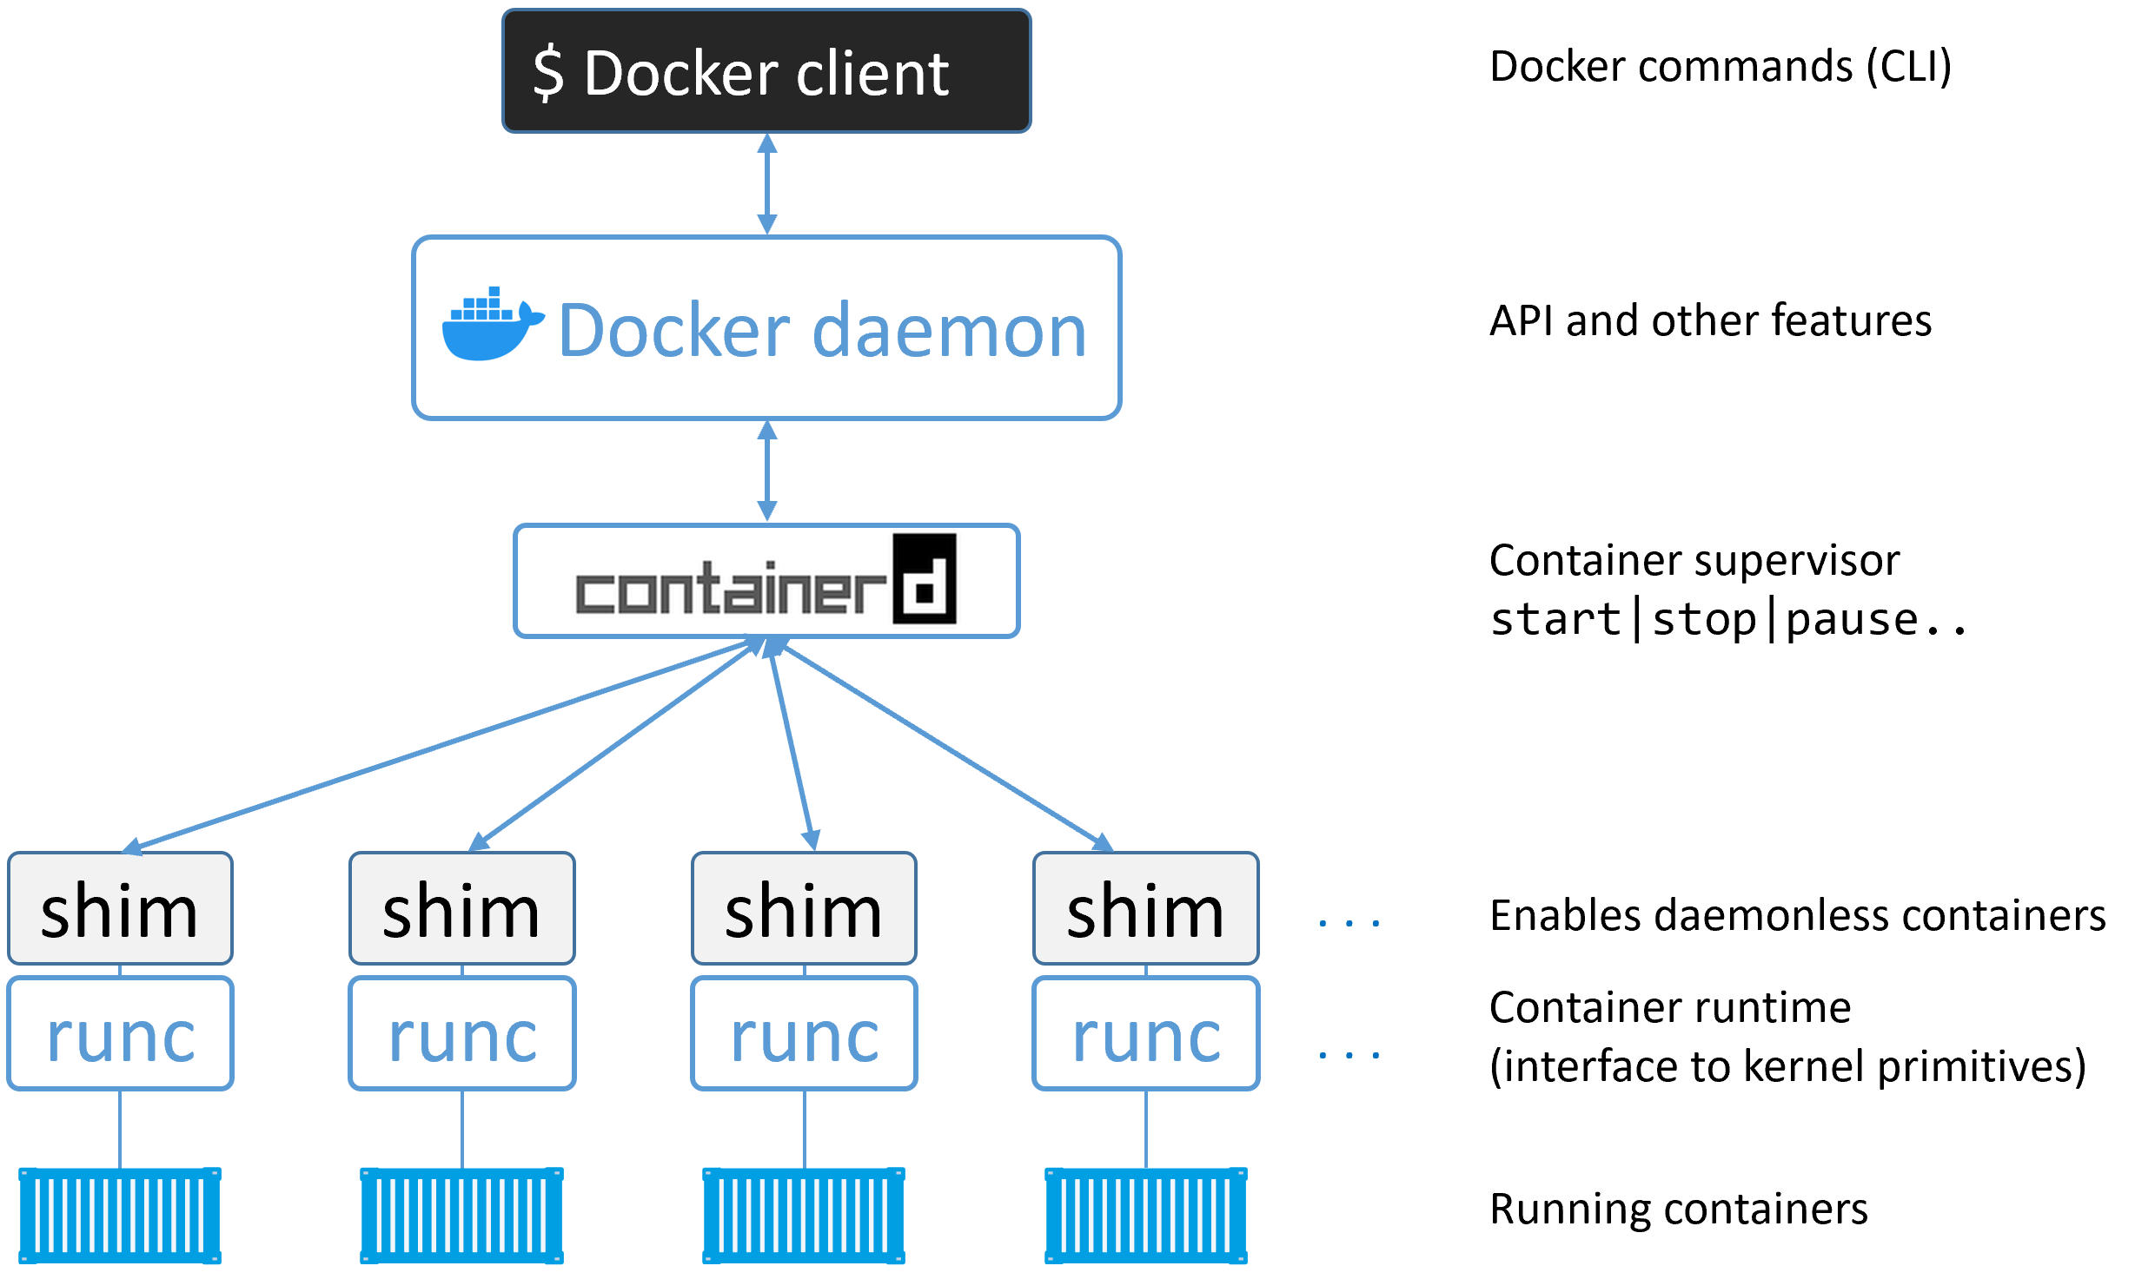
Docker engine architecture

Slide 6
OCI
OCI defines two container-related specifications (a.k.a. standards):
Image spec
Container runtime spec
The Docker engine implements the OCI specifications as closely as possible. For example, the Docker daemon no longer contains any container runtime code — all container runtime code is implemented in a separate OCI-compliant layer. By default, Docker uses runc for this.
The containerd component of the Docker Engine makes sure Docker images are presented to runc as valid OCI bundles.

Slide 7
runc
runc is the reference implementation of the OCI container-runtime-spec.
runc is a small, lightweight CLI wrapper for libcontainer (libcontainer originally replaced LXC as the interface layer with the host OS in the early Docker architecture).
runc has a single purpose in life — create containers.
The layer that runc operates at, “the OCI layer”.

Slide 8
containerd
As part of the effort to strip functionality out of the Docker daemon, all of the container execution logic was ripped out and refactored into a new tool called containerd .
Its sole purpose in life was to manage container lifecycle operations — start | stop | pause | rm....
containerd sits between the daemon and runc at the OCI layer.
over time it has branched out and taken on more functionality. Things like image pulls, volumes and networks.
All the extra functionality is modular and optional, we can pick and choose which bits we want. So, it’s possible to include containerd in projects such as Kubernetes, but only to take the pieces which project needs.

Slide 9
Container Creation
docker container run --name ctr1 -it alpine:latest sh
Once the daemon receives the command to create a new container, it makes a call to containerd.
containerd cannot actually create containers. It uses runc to do that. It converts the required Docker image into an OCI bundle and tells runc to use this to create a new container.
runc interfaces with the OS kernel to pull together all of the constructs necessary to create a container (namespaces, cgroups etc.). The container process is started as a child-process of runc, and as soon as it is started runc will exit.

Slide 10
shim
containerd uses runc to create new containers. It forks a new instance of runc for every container it creates. Once each container is created, the parent runc process exits. This means we can run hundreds of containers without having to run hundreds of runc instances.
Once a container’s parent runc process exits, the associated containerd-shim process becomes the container’s parent.
Shim keeps any STDIN and STDOUT streams open so that when the daemon is restarted, the container doesn’t terminate due to pipes being closed etc.
It also reports the container’s exit status back to the daemon.

Slide 11
The Complete technical picture
On a Linux system, the components we’ve discussed are implemented as separate binaries as follows:
dockerd (the Docker daemon)
docker-containerd (containerd)
docker-containerd-shim (shim)
docker-runc (runc)

Slide 12
daemon
some of the major functionality that exists in the daemon includes, image management, image builds, the REST API, authentication, security, core networking, and orchestration.

Slide 13
Demonstration
The topics in this chapter has no demonstration

